Slide 1
100% stacked column chart
100% stacked column chart is used to display relative percentage of multiple data series in Stacked columns, where the total (cumulative) of each Stacked columns always equals 100%.
For this kind of chart we need two types of data:
2 Text (Less Distribution). E.x –Region, Category, Segment
1 Numerical Data (100% Distribution). E.x - Sales

Slide 2
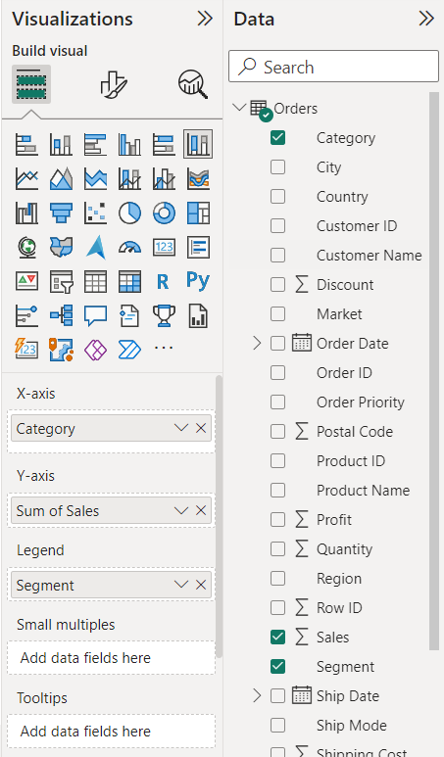
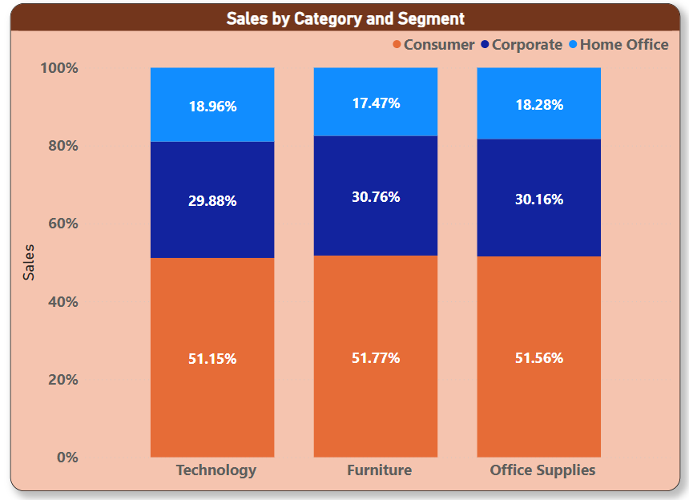
X-axis: Category
Y-axis: Sales
Legend: Segment

